Slide 1
CSC 439/539 Statistical Natural Language Processing Lecture 2: Crash Course in Machine Learning for Text Categorization
Mihai Surdeanu
Fall 2017

Slide 2
Take-away
Understand the task of text categorization
A few fundamental machine learning (ML) algorithms
K Nearest Neighbors (kNN)
Perceptron
Logistic regression
Feed-forward neural networks

Slide 3
Overview
Text categorization
Introduction to categorization algorithms
K Nearest Neighbors (kNN)
Perceptron
Logistic regression
Feed-forward neural networks

Slide 4
Overview
Text categorization
Introduction to categorization algorithms
K Nearest Neighbors (kNN)
Perceptron
Logistic regression
Feed-forward neural networks

Slide 5
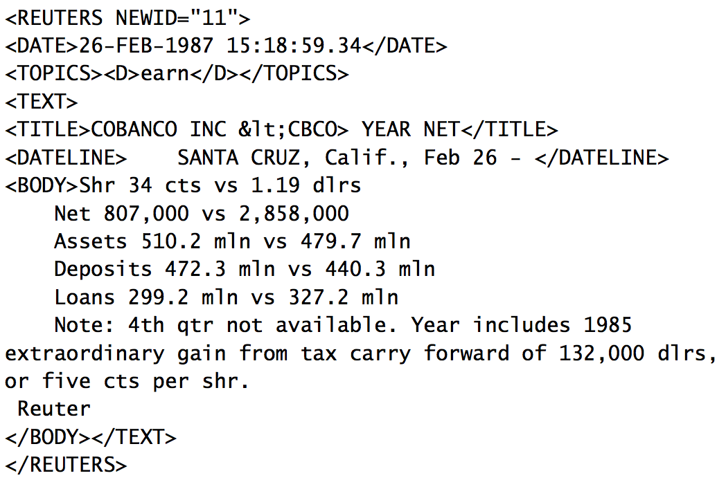
Text categorization example
Earnings

Slide 6
What would you do with such an algorithm?

Slide 7
Text categorization example
ham Go until jurong point, crazy.. Available only in bugis n great world la e buffet... Cine there got amore wat...
ham Ok lar... Joking wif u oni...
spam Free entry in 2 a wkly comp to win FA Cup final tkts 21st May 2005. Text FA to 87121 to receive entry question(std txt rate)T&C's apply 08452810075over18's
ham U dun say so early hor... U c already then say...
ham Nah I don't think he goes to usf, he lives around here though
spam FreeMsg Hey there darling it's been 3 week's now and no word back! I'd like some fun you up for it still? Tb ok! XxX std chgs to send, £1.50 to rcv

Slide 8
Overview
Text categorization
Introduction to categorization algorithms
K Nearest Neighbors (kNN)
Perceptron
Logistic regression
Feed-forward neural networks

Slide 9
Motivation
“I don’t crush the corolla of wonders of the world”
Lucian Blaga, 1919
But I think that for ML, we really should destroy it
To help us become better users of ML software, and, hopefully, designers of new ones
To squash impostor syndrome. We all suffer from it. See this humorous description: http://www.isi.edu/natural-language/people/bayes-with-tears.pdf

Slide 10
Machine learning is not hard

Slide 11

Let’s read a book

Slide 12


Slide 13
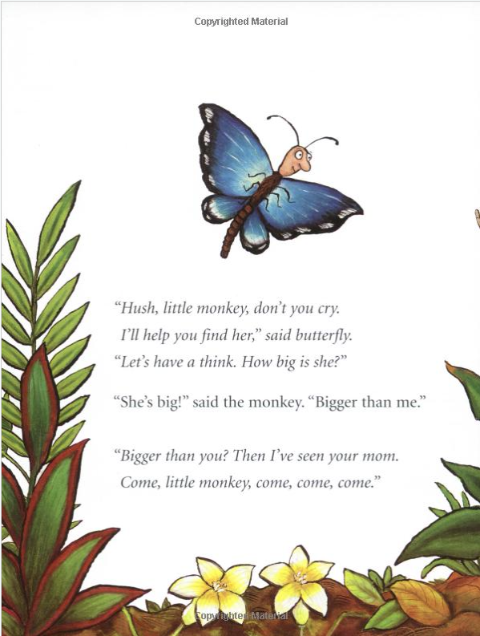

Slide 14
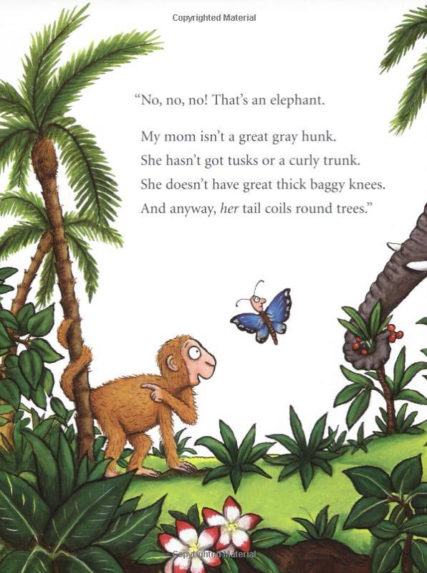

Slide 15
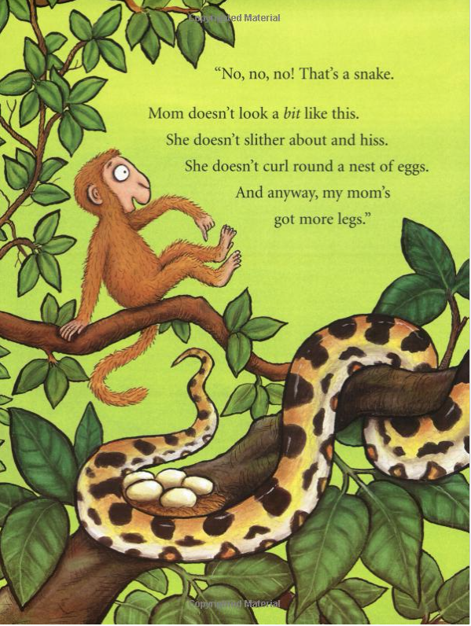

Slide 16
Don’t worry. Eventually, the baby monkey finds her mom.

Slide 17
What have we learned from this book?
Objects are described by their properties, or features
Vector representation, vector length, normalization
A classification algorithm has at its core a similarity function, which measures how similar properties of two objects are
Vector similarity
A good algorithm aggregates its decisions over multiple properties
Algorithms may overfit, if not designed well, or not trained on enough data
Overfitting: when an algorithm performs well in training, but poorly on unseen data (testing)

Slide 18
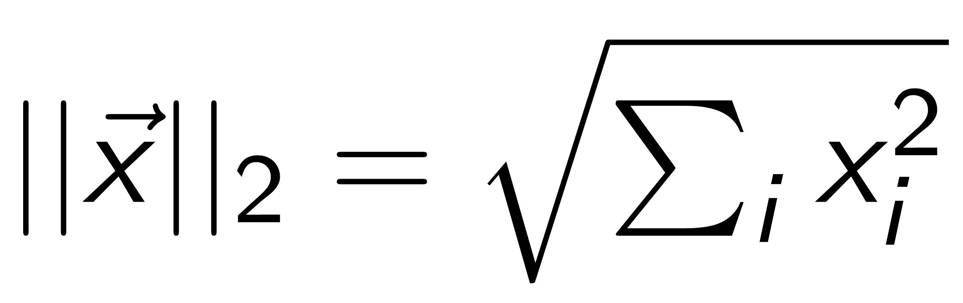
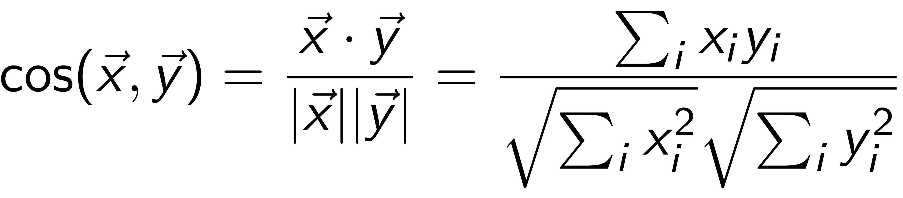
Vector length + cosine similarity
Vector length:
Cosine similarity:

Slide 19
Let’s build some vectors

Slide 20
Representing NLP problems numerically
X: instance-feature matrix, size n x m (n rows, m columns)
n training instances X_{i}
m feature functions f_{j}
X_{i,j} = f_{j} (X_{i}), i.e., the value of feature function f_{j} for X_{i}
Y: vector of labels, length n
Feature functions F
Y: labels
X: training instances
Slide by Erwin Chan

Slide 21
Definitions: instances, features, and labels
Instances
X = { X₁, X₂, …, X_{n} }: set of all instances in the data
X_{i}: an individual instance
Features
F = { f₁, f₂, …, f_{m} }: a set of feature functions
X_{i} = [ f₁(X_{i}), f₂(X_{i}), …, f_{m}(X_{i}) ] is a vector of features, i.e., the result of applying each feature function in F to the instance X_{i}
Labels
Set of possible labels: Y = { y₁, y₂, …, y_{k} }
Binary classification: |Y| = 2
Multiclass classification: |Y| > 2
Classification: for an instance X_{i}, predict a label y_{i} ∈ Y
Regression: labels are continuous numeric values
Adapted from slide by Erwin Chan

Slide 22
(Powerpoint) Notations
Scalars: lower case characters
Vectors of scalars: upper case characters
Matrices, or vectors of vector: bold upper case characters

Slide 23
Have we understood?
Features
Feature vectors
Vector normalization
Cosine similarity, dot product

Slide 24
Overview
Text categorization
Introduction to categorization algorithms
K Nearest Neighbors (kNN)
Perceptron
Logistic regression
Feed-forward neural networks

Slide 25
kNN
Perhaps the simplest categorization algorithm
Rationale: to classify a new object find the object in the training set that is most similar (1NN)
Not very robust: one document could be mislabeled or atypical
Generalization: assign each object to the majority class of its k nearest neighbors in the training set (kNN)

Slide 26
Probabilistic kNN
Probabilistic version of kNN: P(c|d) = fraction of k neighbors of d that are labeled with class c
kNN classification rule for probabilistic kNN: Assign d to class c with highest P(c|d)

Slide 27
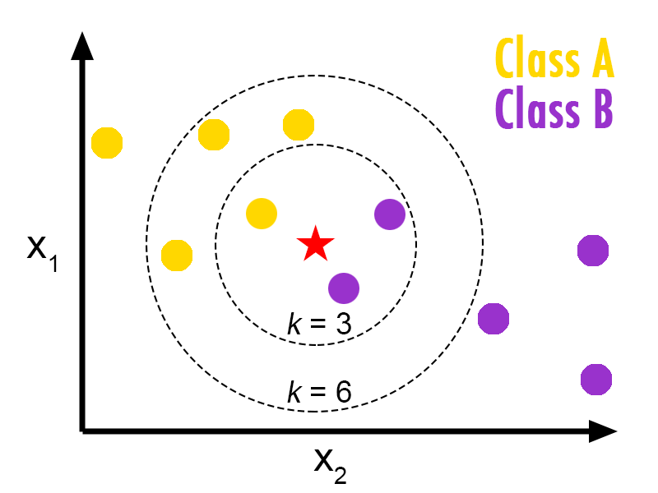
Exercise
How is star classified for k = 3; k = 6?

Slide 28
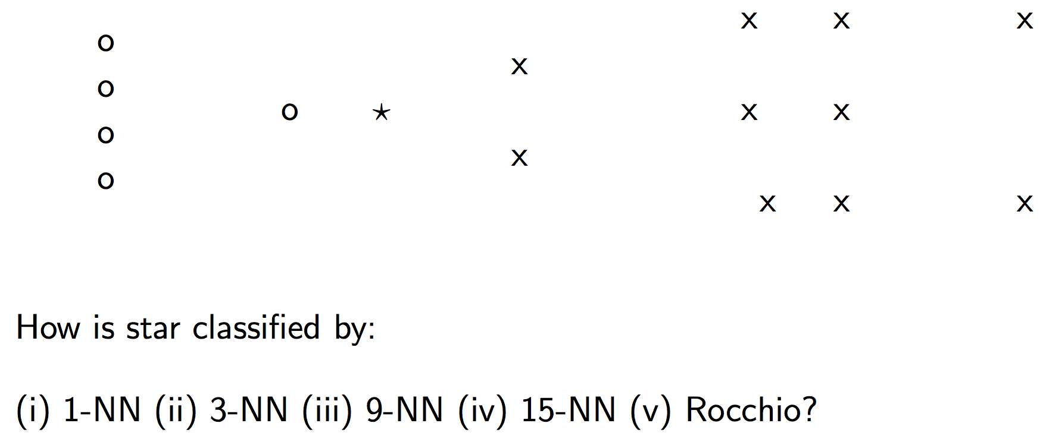
Exercise

Slide 29
What kNN needs
Representation of objects as vectors
A similarity function between two vectors
Cosine similarity
Euclidian distance

Slide 30
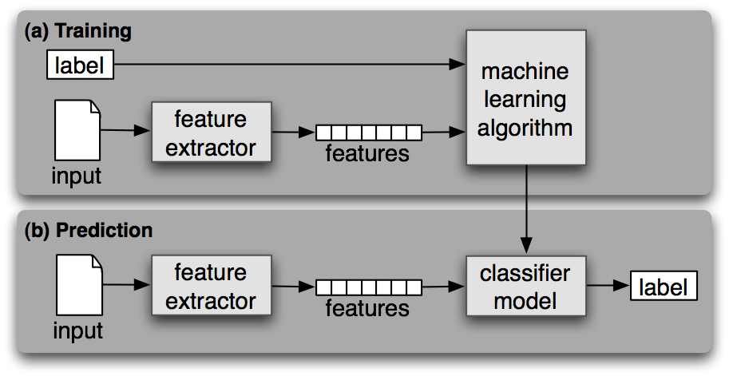
Architecture of ML algorithms

Slide 31
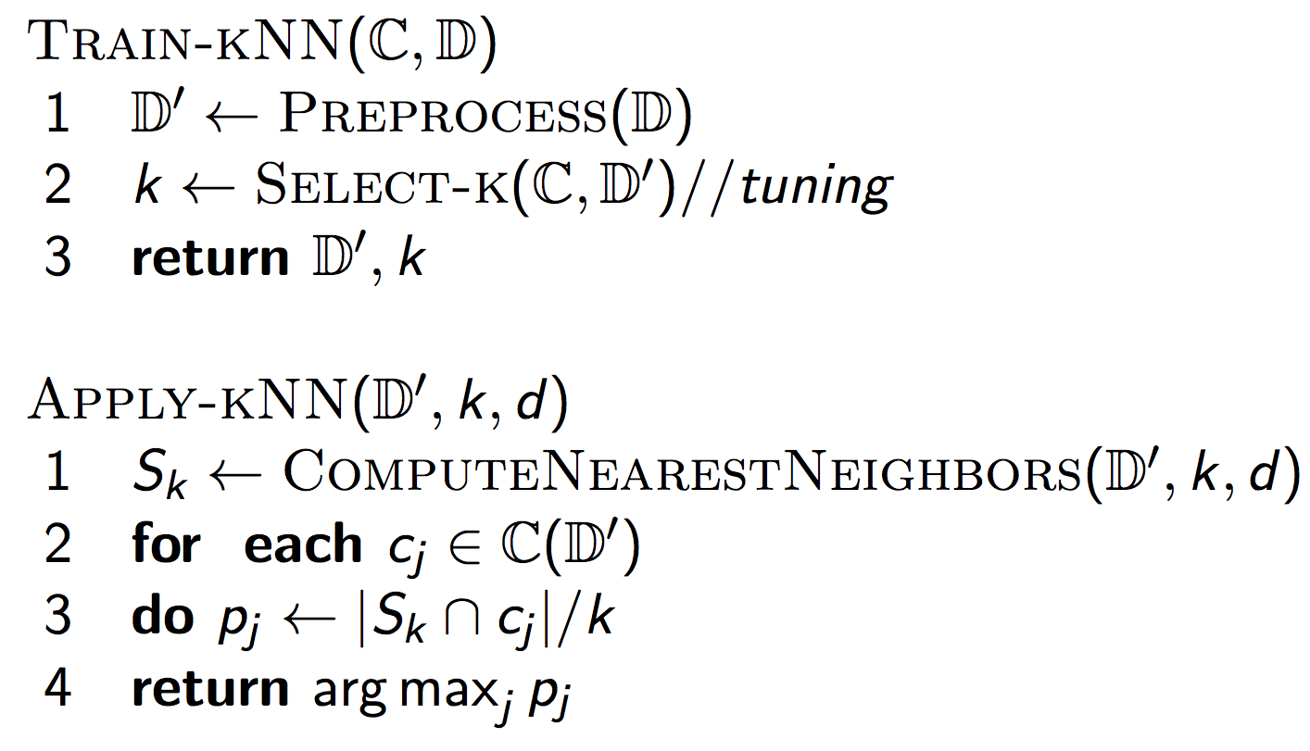
kNN algorithm

Slide 32
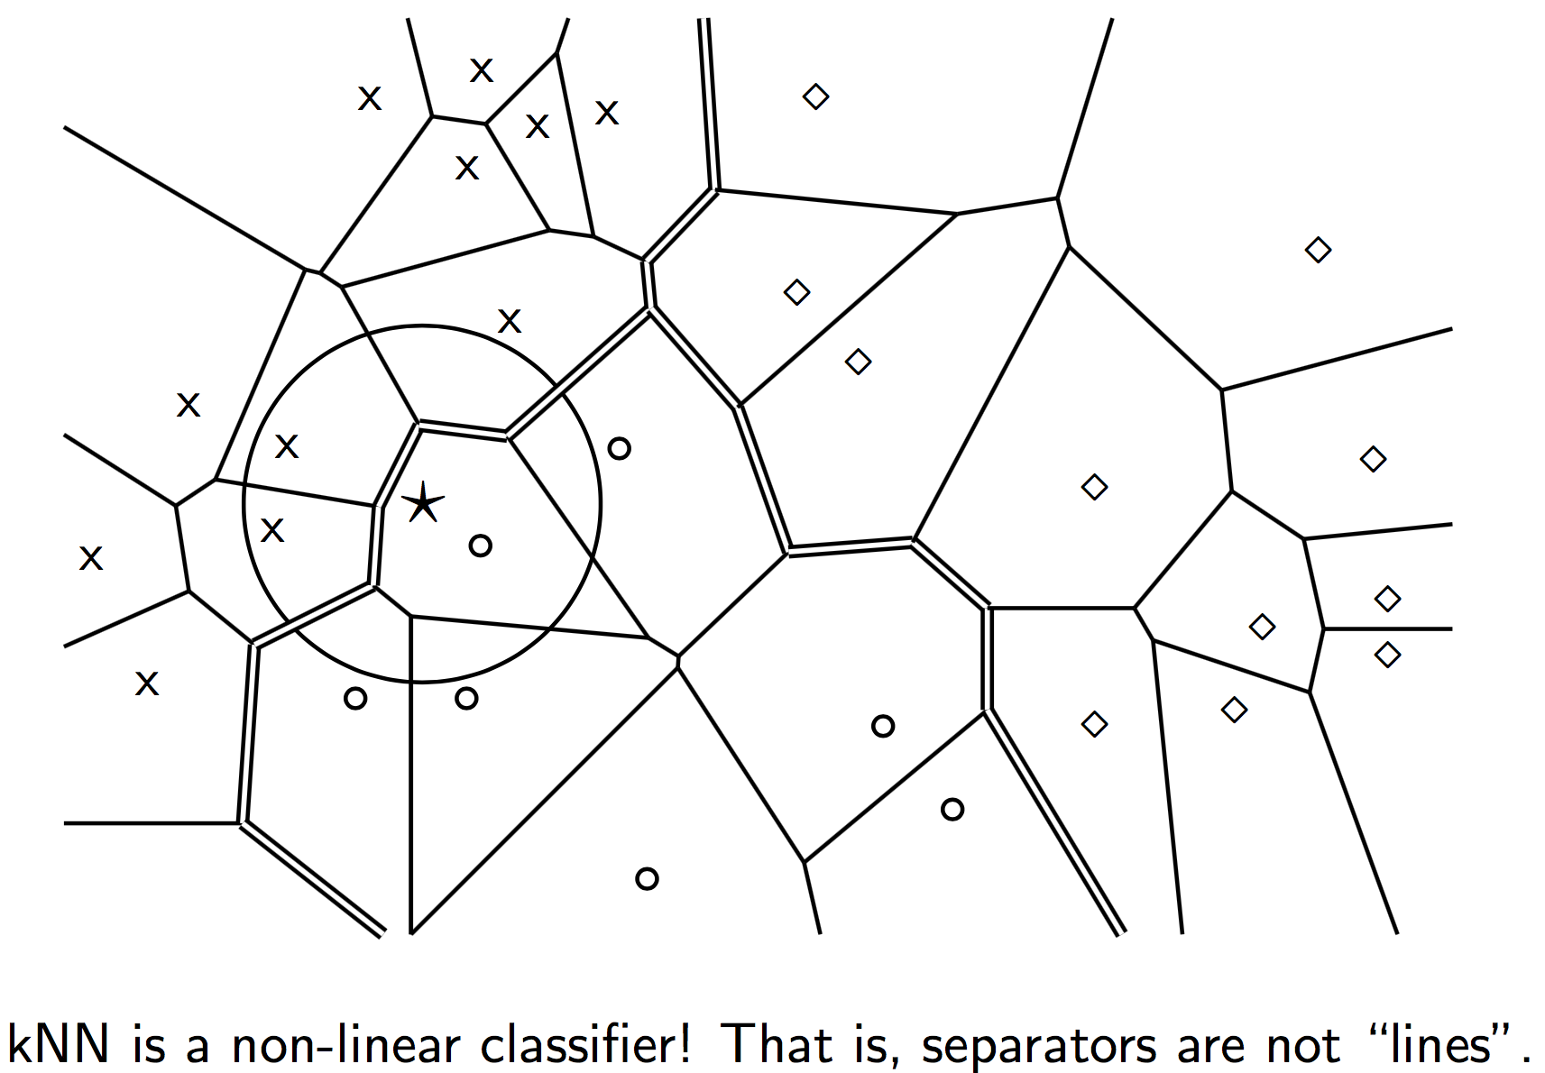
kNN is based on Voronoi tesselation

Slide 33
What is the fundamental problem with kNN?
The overhead of prediction is high
We potentially have to inspect all the objects seen in training to discover the closest neighbors for a new object
We must condense what we learn from training into something more compact, which could be applied quickly at prediction time

Slide 34
Averaging the vectors per class does not work too well
Rocchio algorithm:
Compute a centroid for each class
The centroid is the average of all documents in the class.
Assign each test document to the class of its closest centroid.
What is the runtime of this algorithm at prediction time?

Slide 35
Exercise
Let’s build a Rocchio classifier

Slide 36
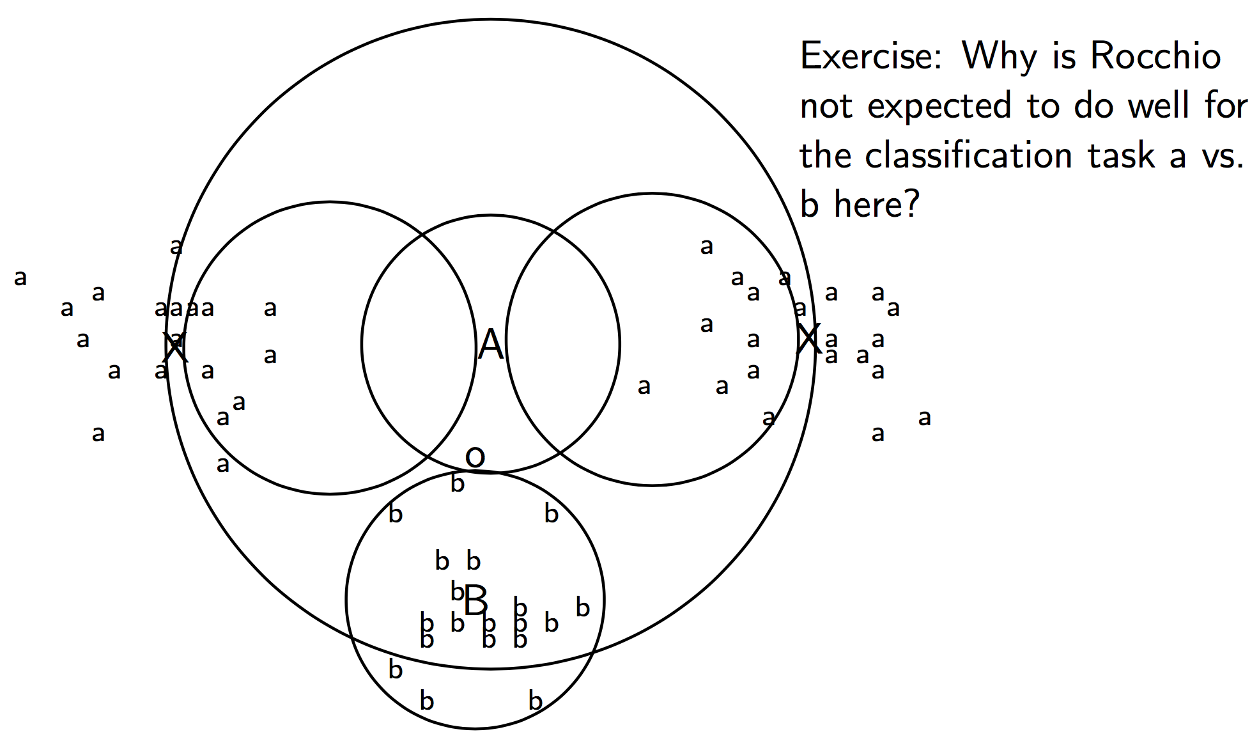
Rocchio cannot handle multimodal classes

Slide 37
Overview
Text categorization
Introduction to categorization algorithms
K Nearest Neighbors (kNN)
Perceptron
Logistic regression
Feed-forward neural networks

Slide 38
Rationale
Error driven learning: update what is learned only when the classifier makes a mistake in training
Ignore objects that are classified correctly
Focus on the “hard” ones

Slide 39
Perceptron decision
Learns a single vector W (for binary classification)
Decision:
Decide “yes” iff f(X) = W ∙ X – Theta > 0
Decide “no” otherwise
Bias term
Dot product

Slide 40
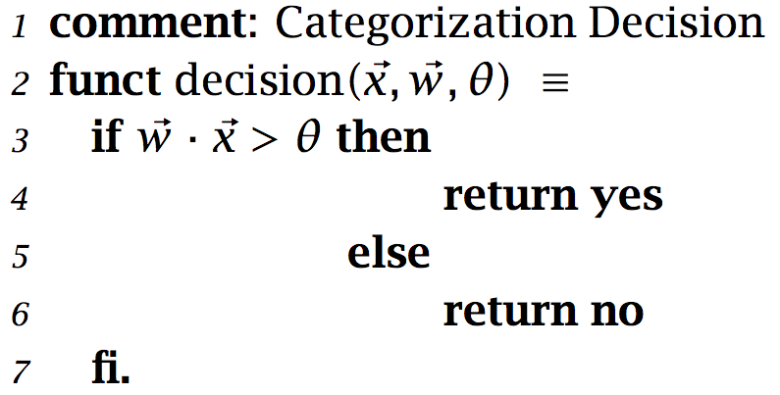
Algorithm (1/2)

Slide 41
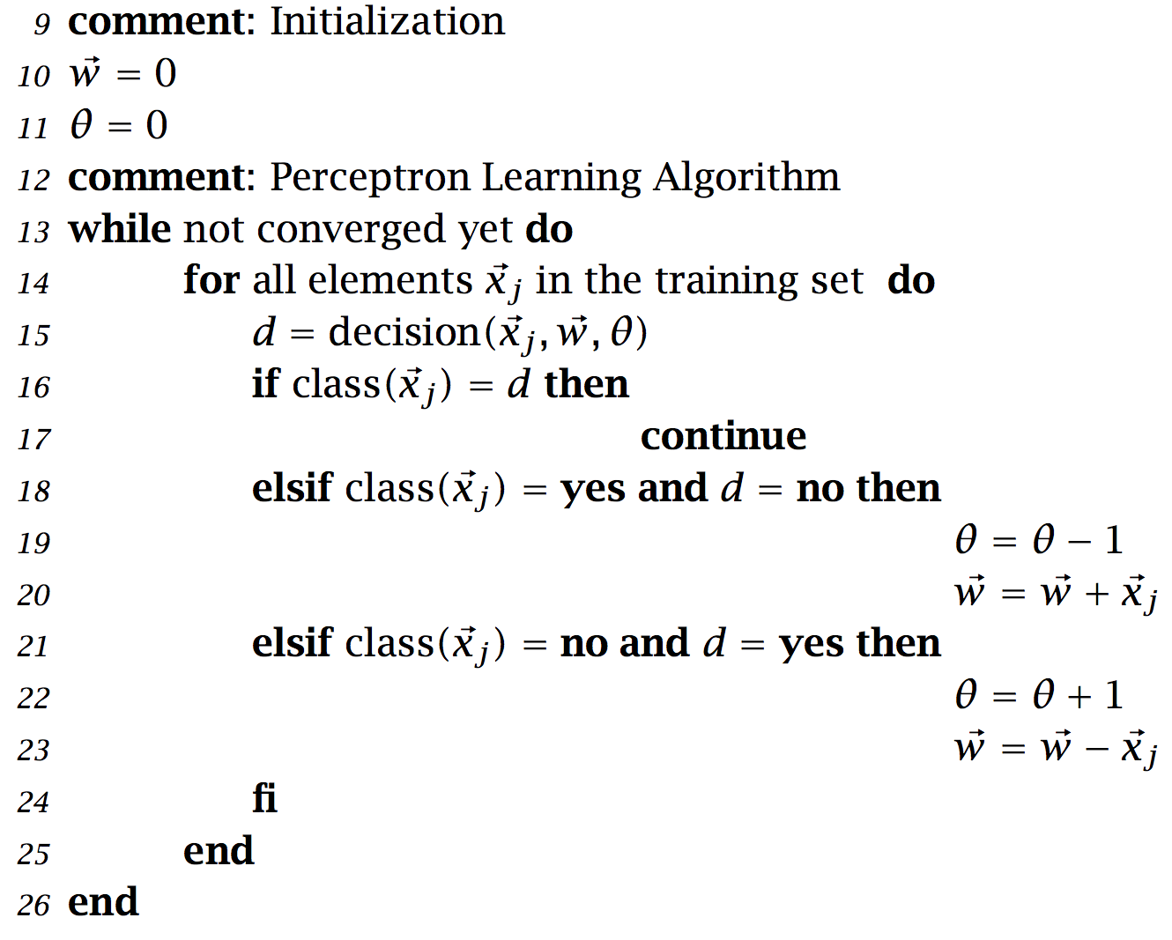
Algorithm (2/2)

Slide 42
Exercise
Let’s build a Perceptron

Slide 43
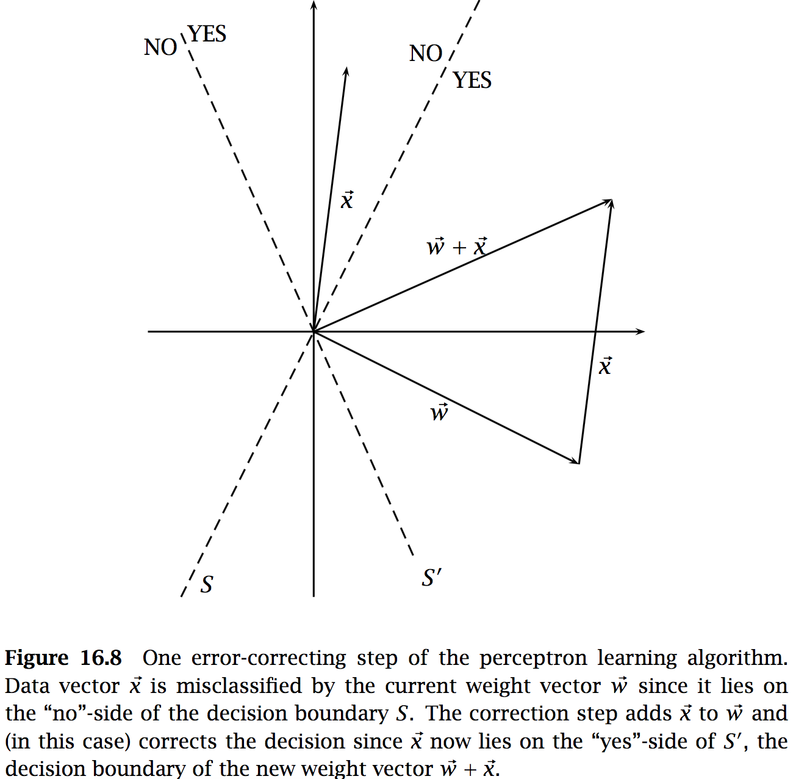
Visualization

Slide 44
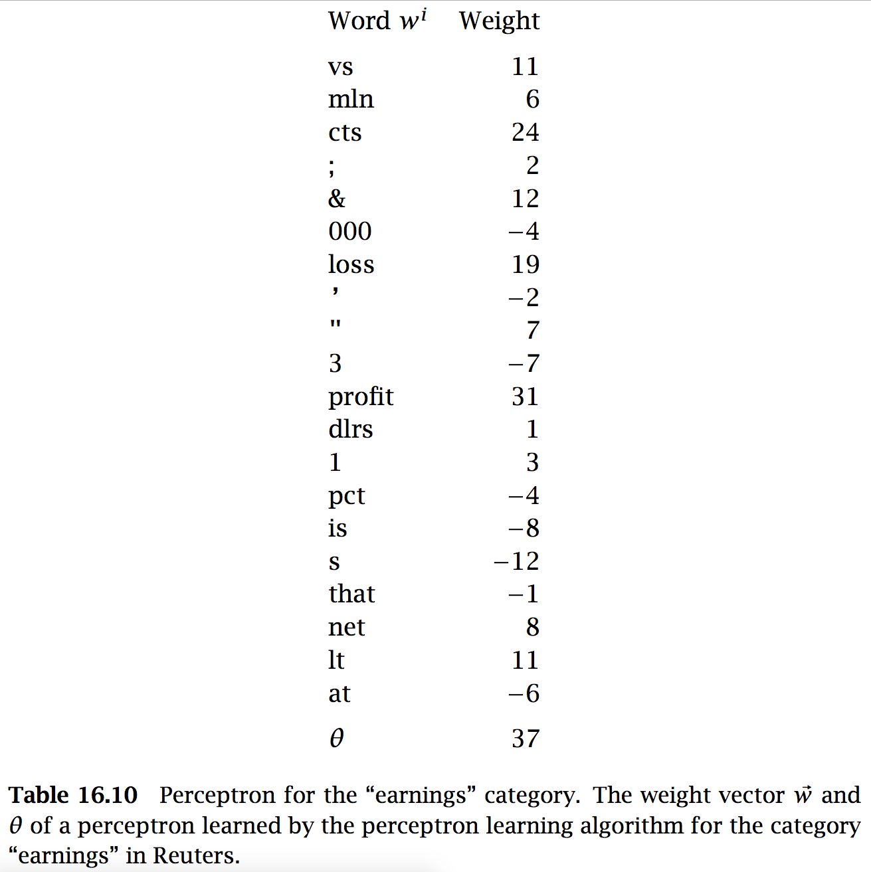
Real-world example

Slide 45
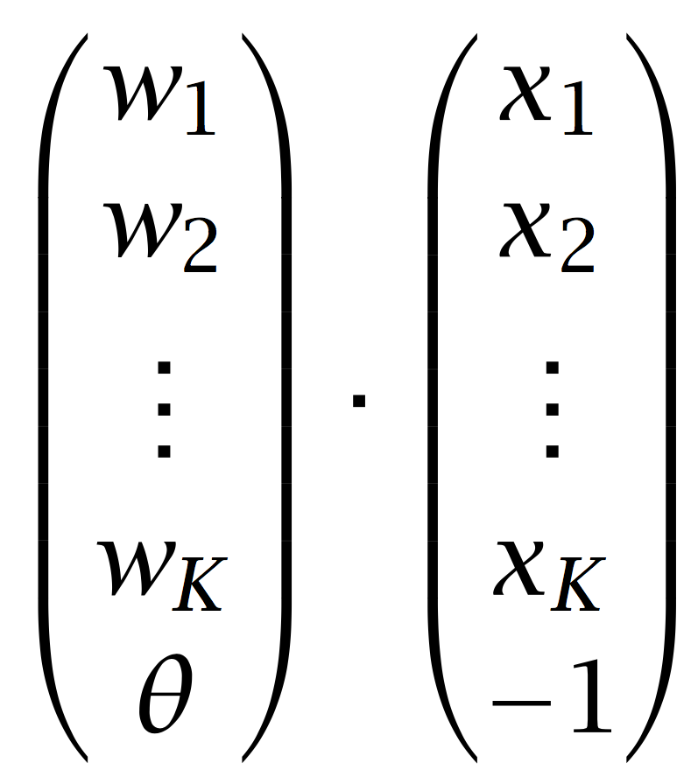
Simplifying the bias term
In many implementations, the bias term is folded into the vectors W and X:
The decision then becomes simply W ∙ X > 0
And the updates work only with W (let’s check!)

Slide 46
Simplifying the bias term

Slide 47
Ensemble models and average Perceptron
In most situations, voting between multiple classifiers improves performance
It is also a cheap way to build a non-linear classifier from a bunch of linear ones

Slide 48
Voting
Term typically used when the individual classifiers are not directly related
Different ML models; different features; etc.
Worth $1M: see the Netflix prize
Types of voting
Unweighted voting: pick majority choice
Weighted voting: weigh votes by, say, accuracy over a controlled set (development) or confidence of each prediction

Slide 49
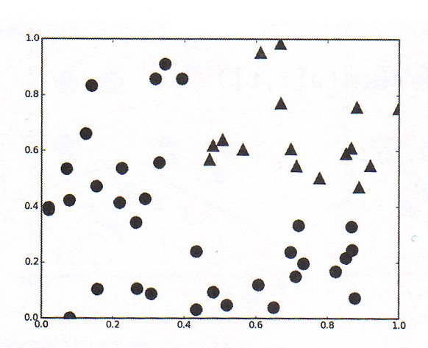
Example: Apply voting to this data

Slide 50
Classifier A
YES
NO
Slide by Erwin Chan

Slide 51
Classifier B
NO
YES
Slide by Erwin Chan

Slide 52
Correct decision boundary through majority vote
1 vote
2 votes
0 votes
1 vote
Slide by Erwin Chan

Slide 53
Prediction overhead
But prediction overhead is high again, linear in the number of individual classifiers
Averaging is a cheap way of reaping most benefits of voting

Slide 54
Averaging
avgW += W
avgW += W
avgW /= number-of-updates

Slide 55
Averaging
Decision:
Decide “yes” iff f(X) = avgW ∙ X > 0
Decide “no” otherwise

Slide 56
What are the fundamental problems with the Perceptron?
The basic or averaged Perceptrons only model linearly-separable data
No ”smooth” updates
The vector W is updated equally for big or small mistakes…
Hard to generalize, because the model “jumps around” good solutions

Slide 57
Overview
Text categorization
Introduction to categorization algorithms
K Nearest Neighbors (kNN)
Perceptron
Logistic regression
Feed-forward neural networks

Slide 58
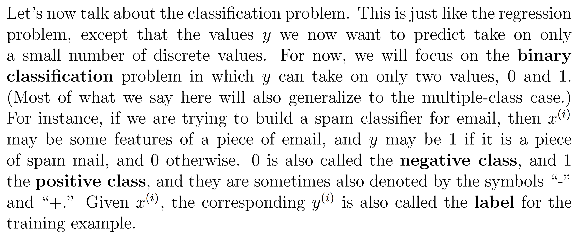
Binary classification notations
All slides on logistic regression come from Andrew Ng’s CS229 course at Stanford

Slide 59
Some notation changes
Just as before, the bias term (Theta in the Manning textbook) is folded in the X and W vectors
But here we will use Theta to denote the weights learned by the model (known as W in the Manning textbook)

Slide 60
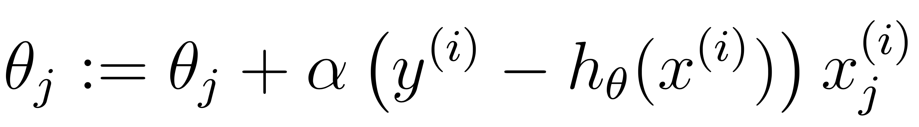
Looking ahead: A better update rule
This is what LR does and it is much better than the Perceptron update. Why?
(h is the decision function)

Slide 61
Let’s see how we can derive this update rule

Slide 62
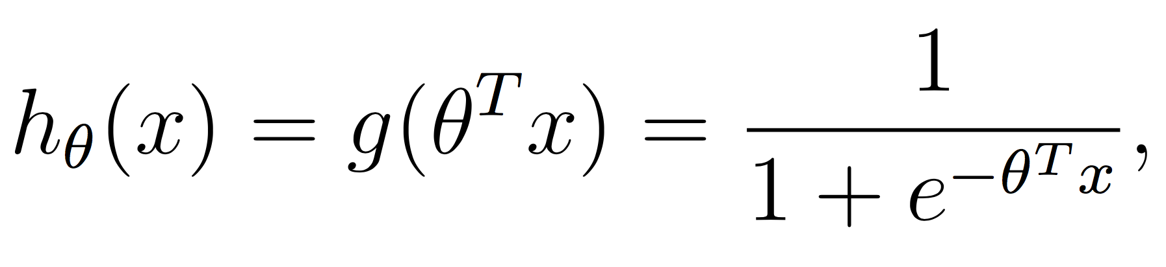
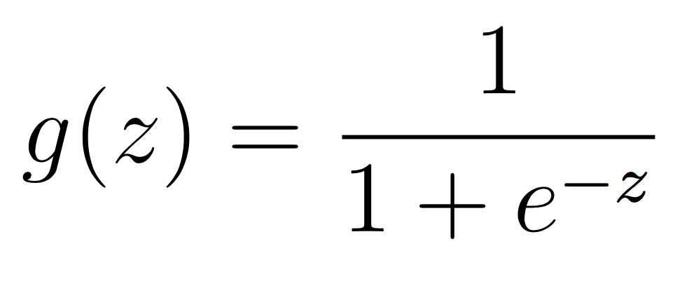
Improvement 1: Decision function
g = sigmoid function, or logistic function

Slide 63
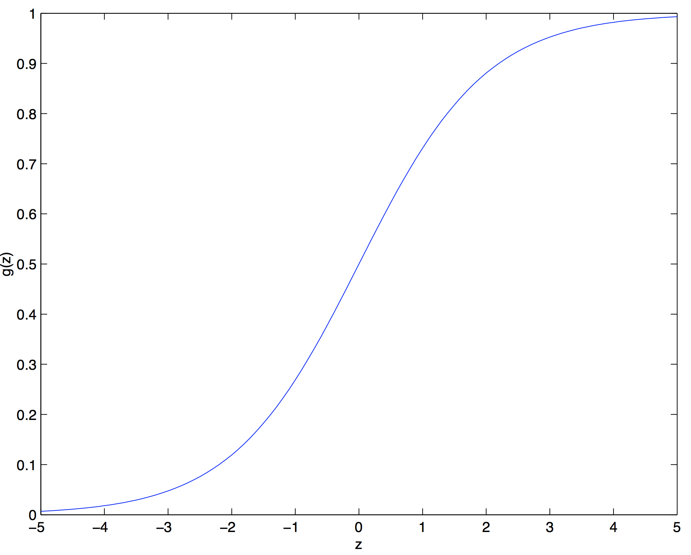
Decision function

Slide 64
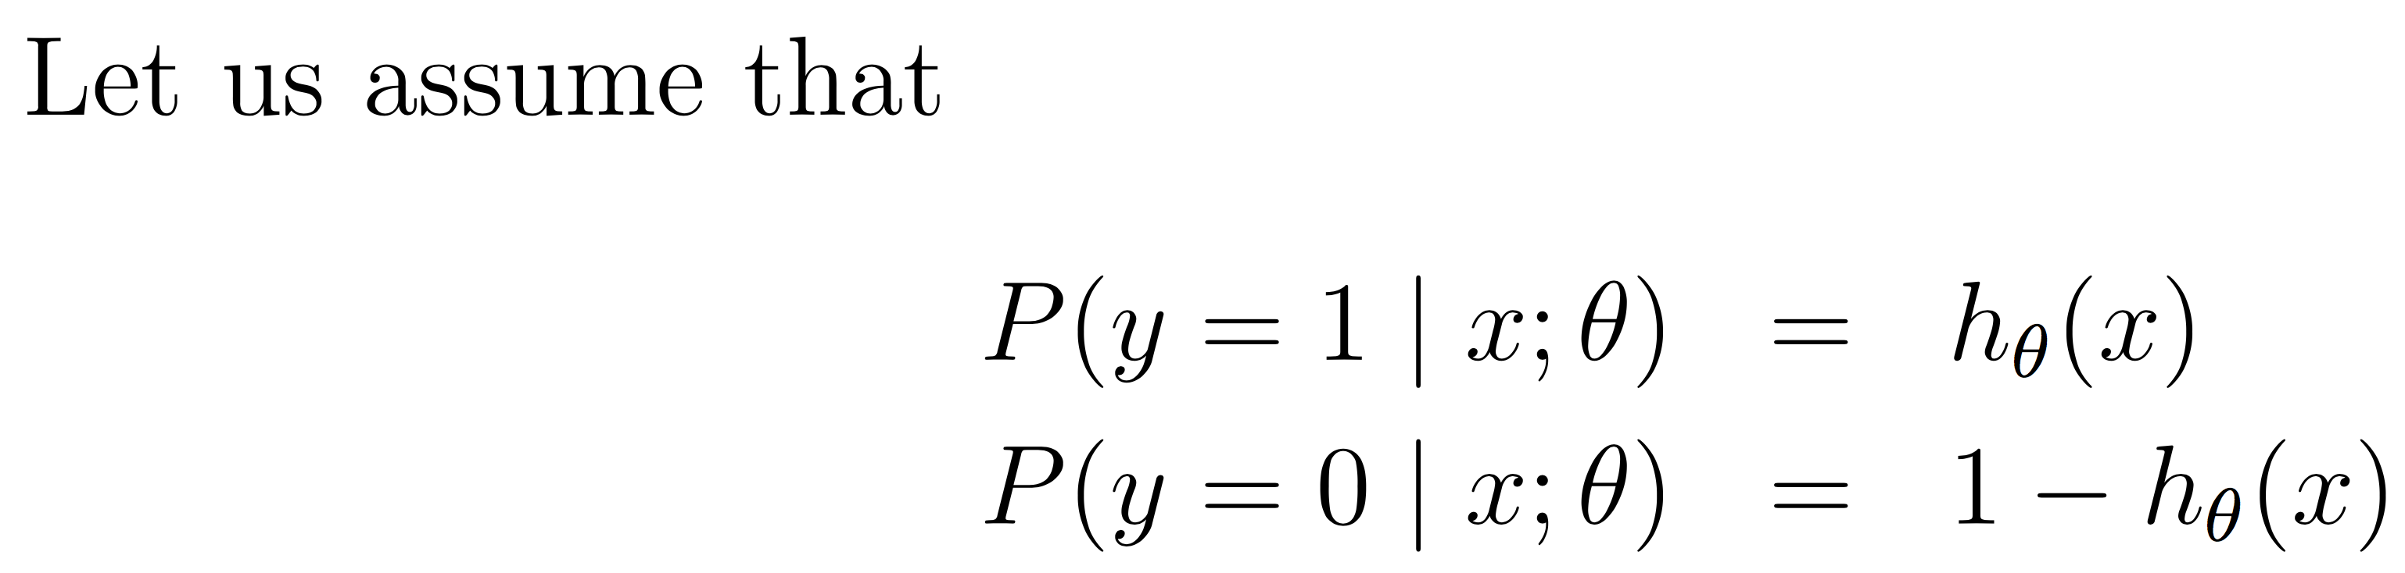
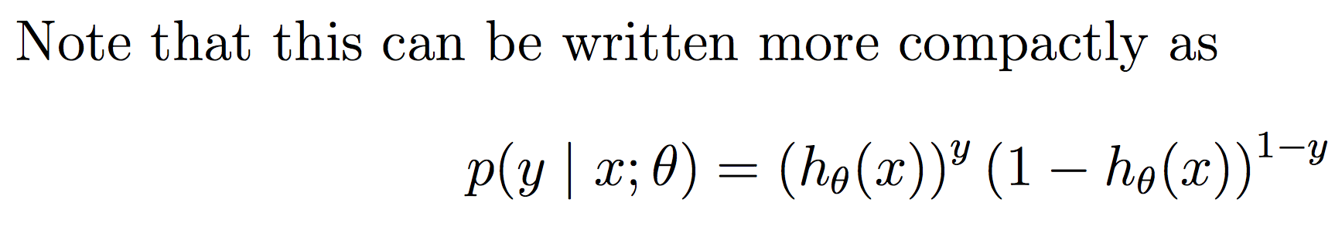
Decision function
Why does this make sense?

Slide 65
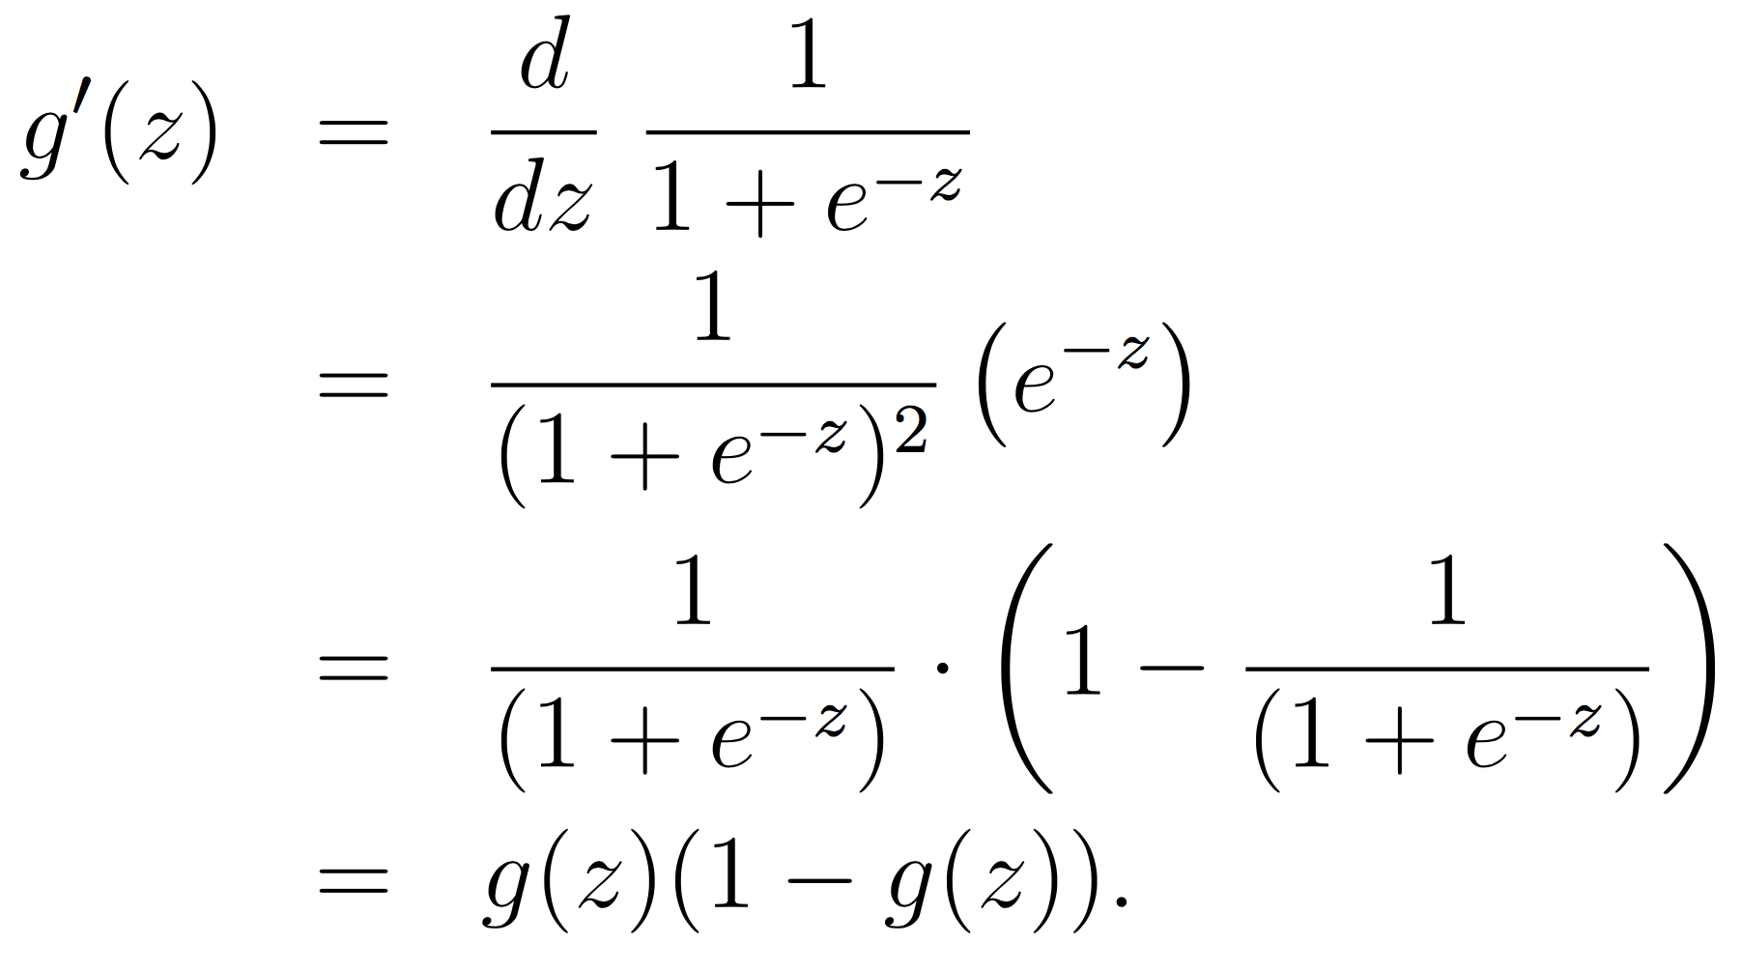
Decision function’s derivative (for later)
Use the differentiation rules to derive this yourself:
https://en.wikipedia.org/wiki/Differentiation_rules

Slide 66
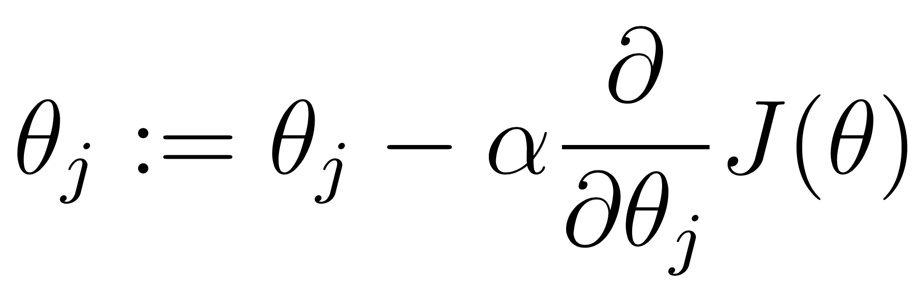
Improvement 2: Cost function and gradient descent/ascend
Given a training set, how do we learn the parameters Theta to make h(x) close to y?
To formalize this, we will use a cost function, J, which measures how close h(x) is to y
Given such a function, we will use the gradient descent algorithm, which starts with some initial Theta, and repeatedly performs the update:
Takes a step in the direction of steepest decrease of J.

Slide 67
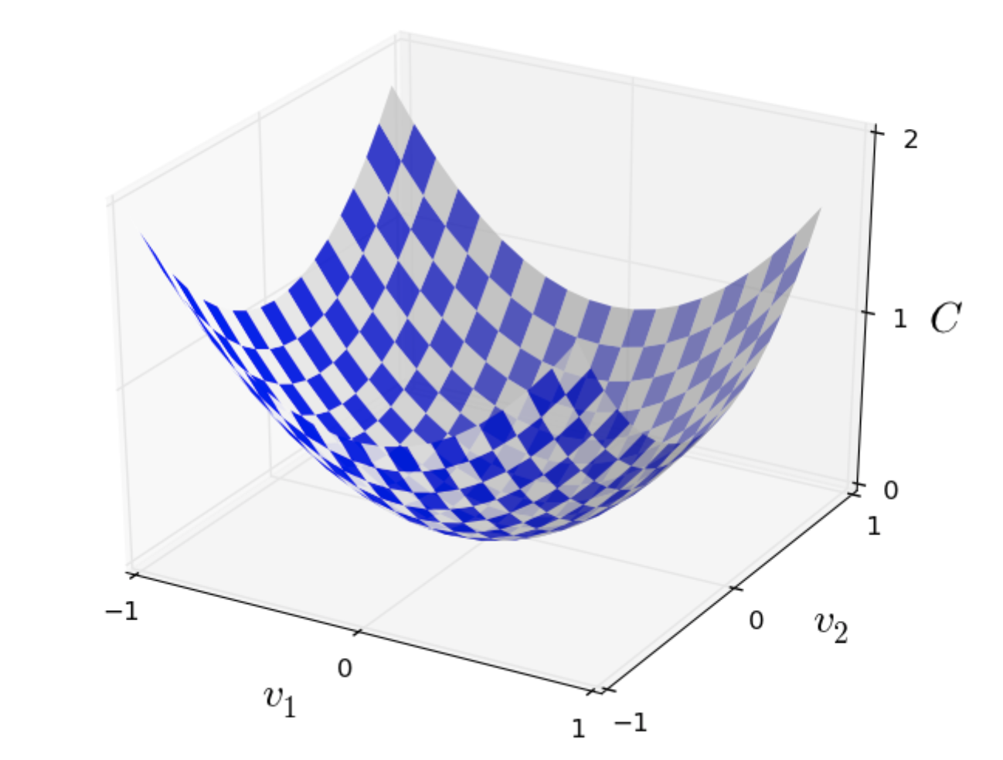
Gradient descent

Slide 68
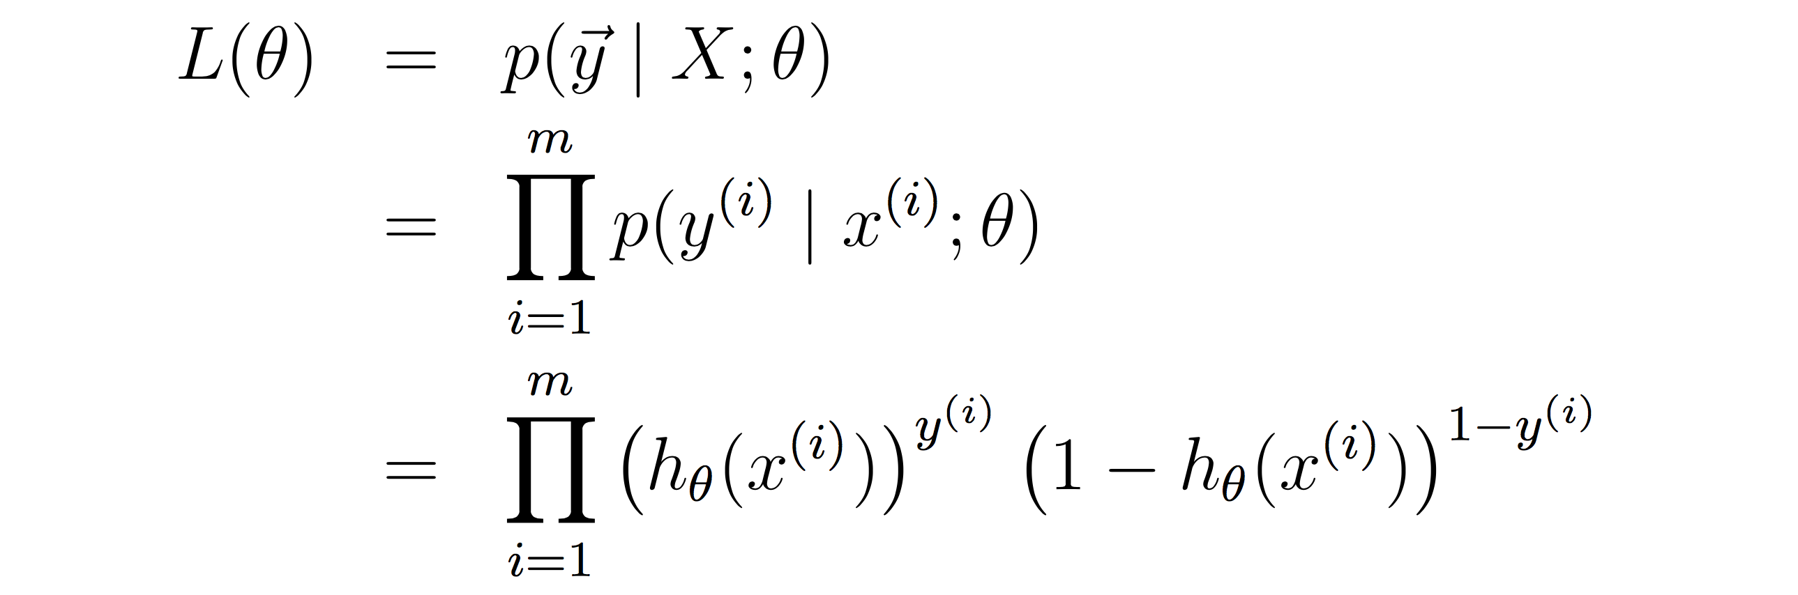
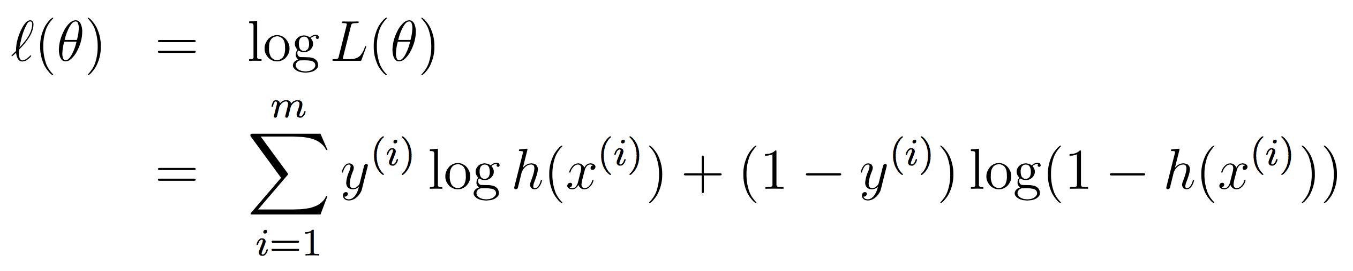
Cost function for LR = Log likelihood
J = l(Theta) = log L(Theta) = log p(Y|X; Theta)

Slide 69
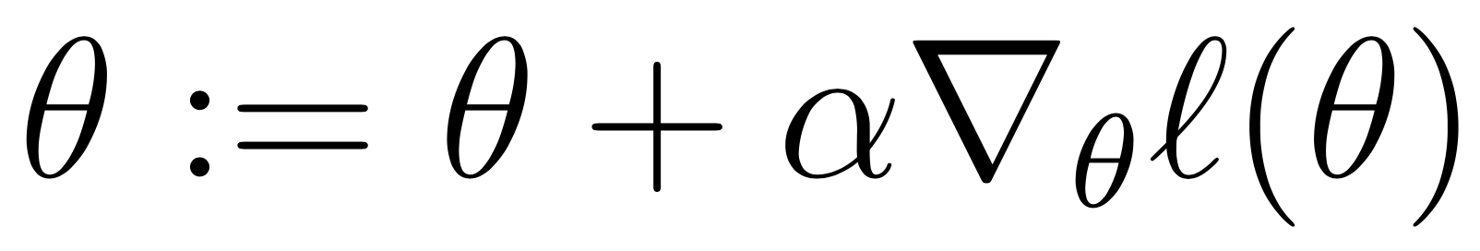
Note
In the case of LR, we want to maximize J, so we will perform gradient ascent:

Slide 70
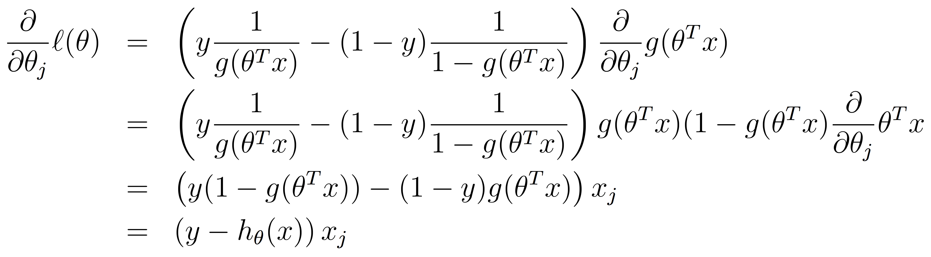
Computing the partial derivatives
We are applying the chain rule twice here! See:
https://en.wikipedia.org/wiki/Differentiation_rules

Slide 71
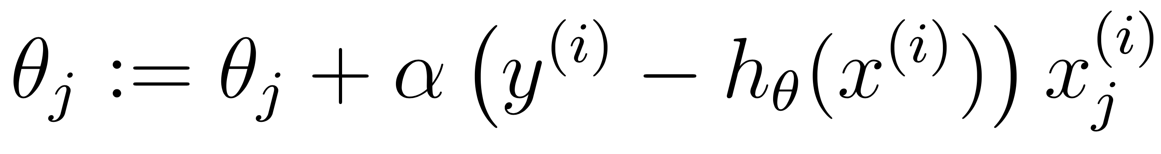
Stochastic gradient ascent
“Stochastic” because we perform updates after every training example
“Batch”
Perform 1 update for 1 pass over the entire training dataset
Almost never used in practice (why?)

Slide 72
The update rule
This is much better than the Perceptron update. Why?

Slide 73
Exercise: write the whole LR training algorithm

Slide 74
Limitations
The decision function is linear (in log space)
Feature design is hard for most real-world NLP problems…

Slide 75
Overview
Text categorization
Introduction to categorization algorithms
K Nearest Neighbors (kNN)
Perceptron
Logistic regression
Feed-forward neural networks

Slide 76
What did you find hard about ML so far?
We need to design custom decision functions (e.g., dot product, sigmoid), and custom cost functions
But then we have to recompute all the derivatives. Derivatives are a pain…
Feature design is hard for real-world NLP applications

Slide 77
Advantages of neural networks
Custom, non-linear decision and cost functions
Auto-differentiation to compute derivatives automatically
Automatic generation of feature vectors for all data points (next lecture)

Slide 78
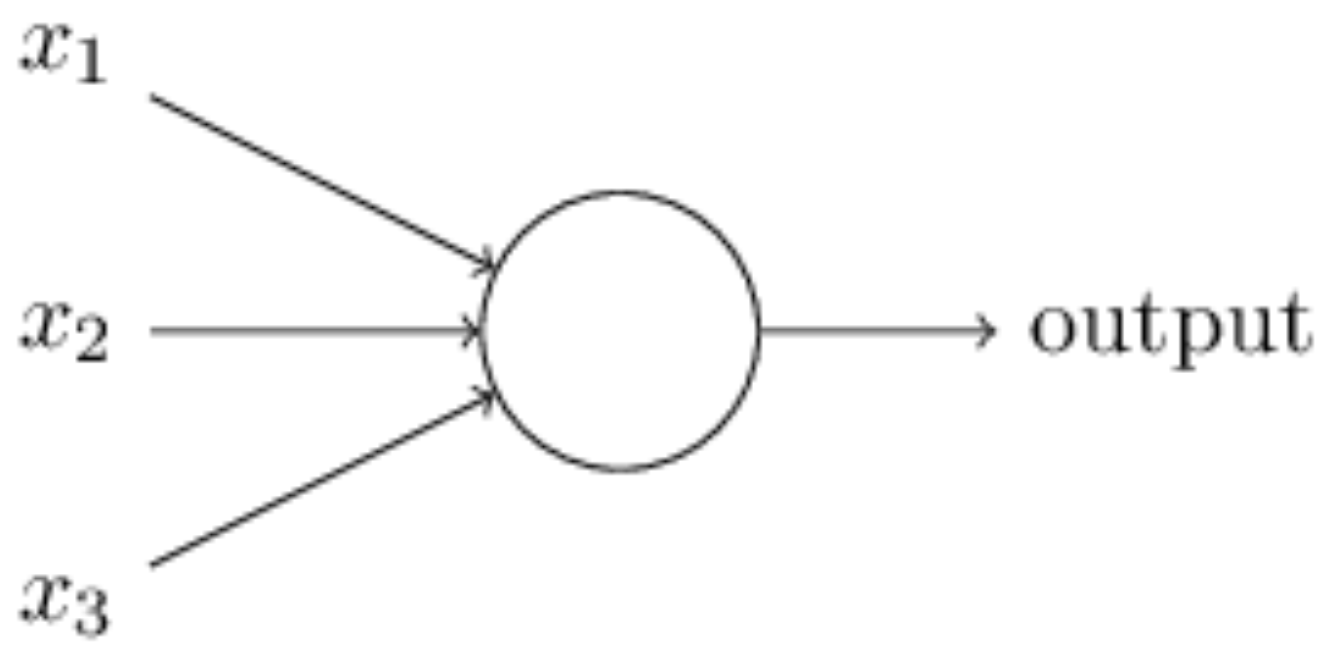
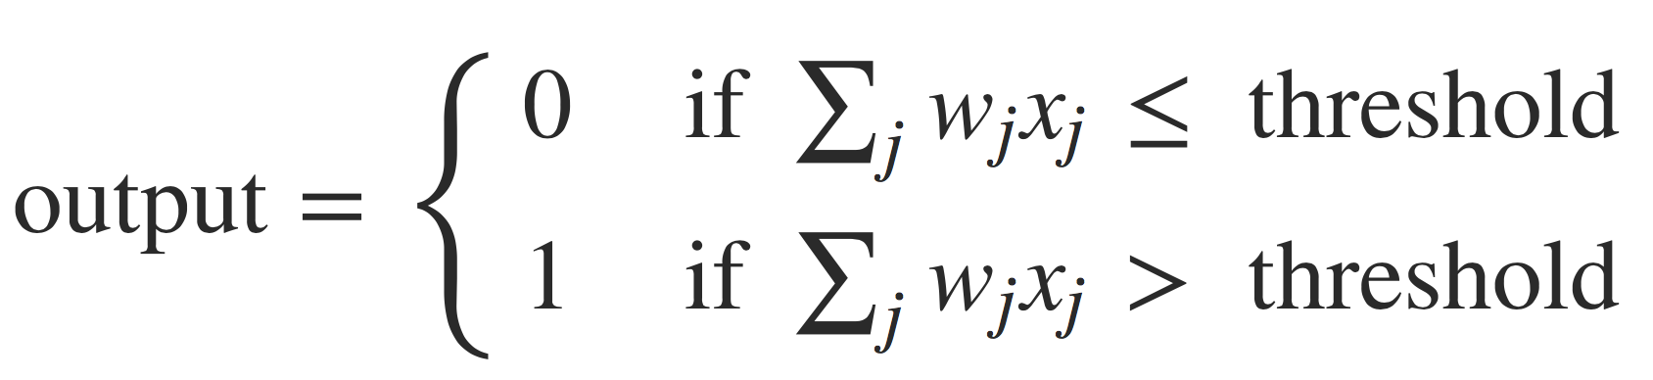
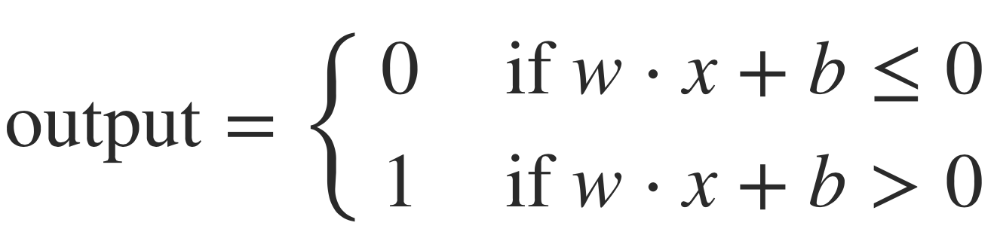
Perceptron architecture
or:
All slides on logistic regression come from http://neuralnetworksanddeeplearning.com/

Slide 79
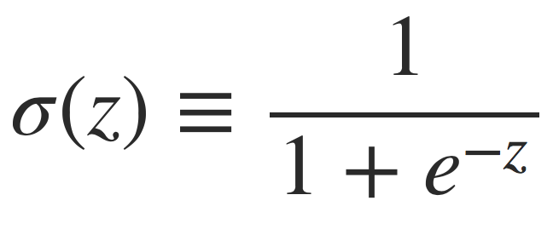
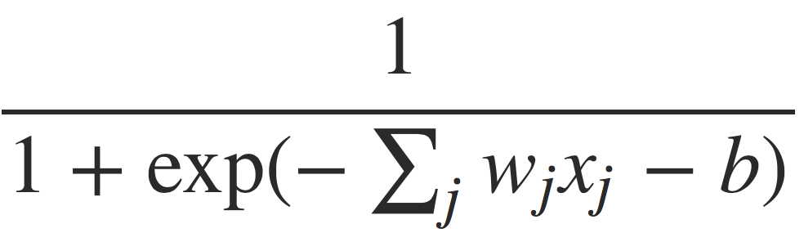
LR architecture
where z is the dot product of W and X (plus bias):

Slide 80
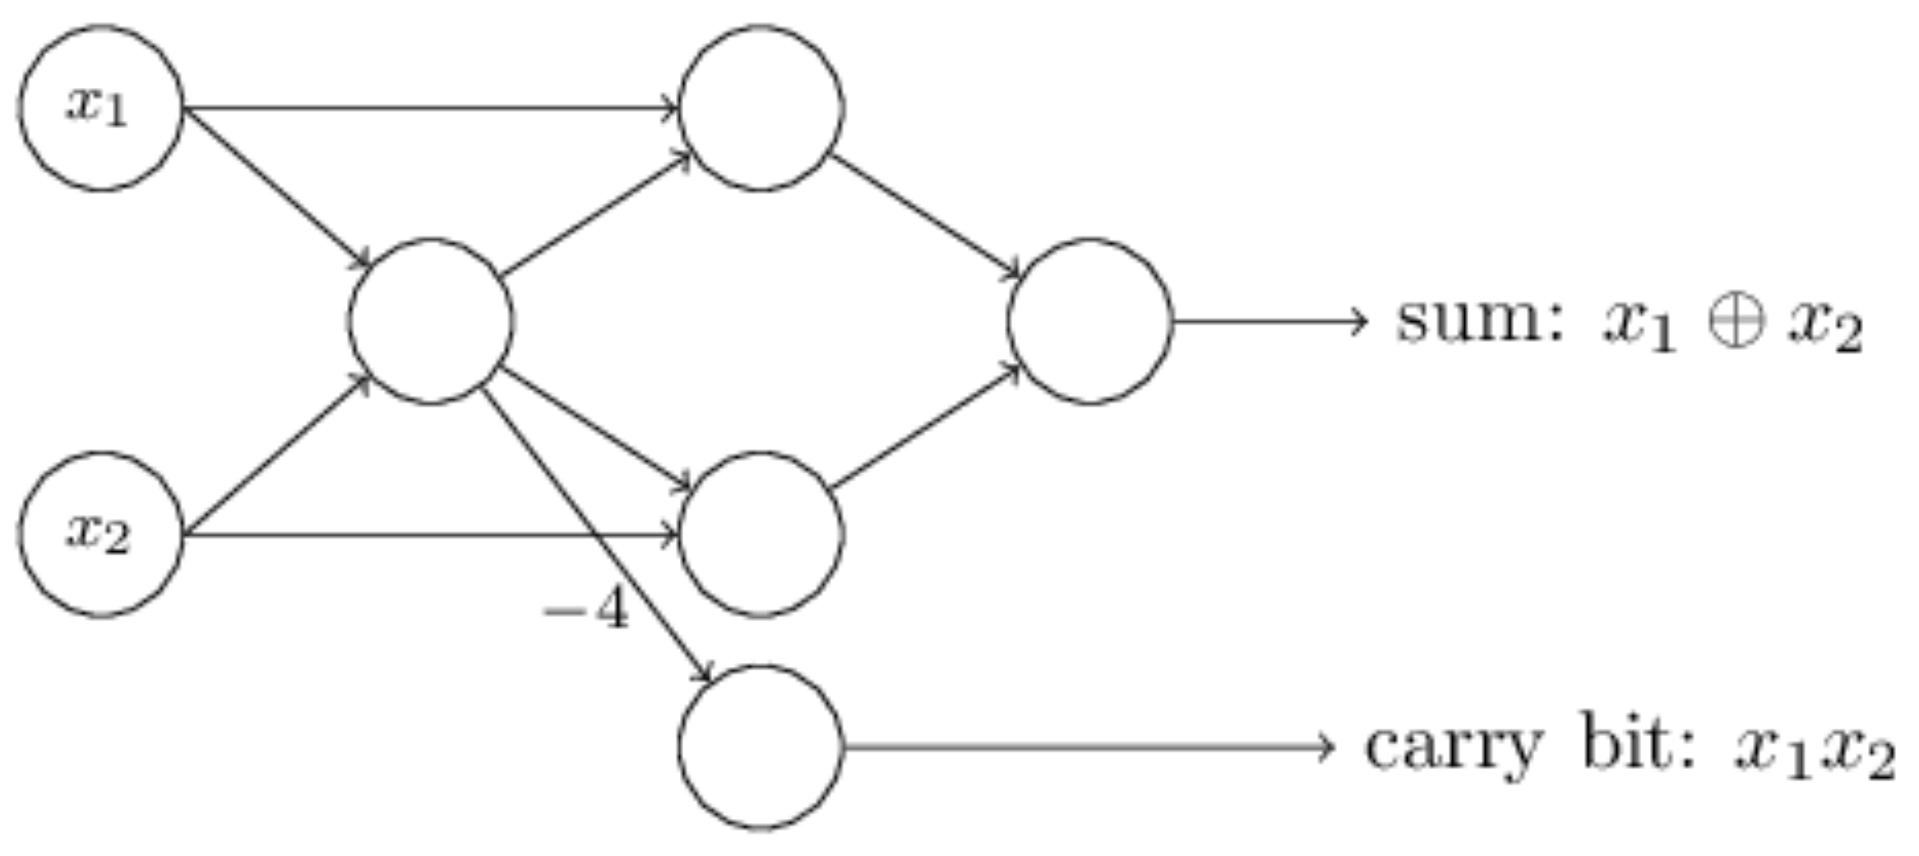
Many other architectures are possible…
See http://neuralnetworksanddeeplearning.com/chap1.html for this discussion.

Slide 81
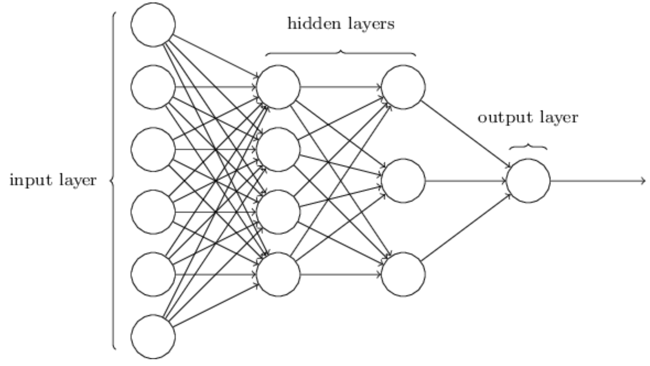
Feed forward neural networks
Each “neuron” implements an activation function, e.g., sigmoid, using the edge weights
There is a weight on each edge in the NN

Slide 82
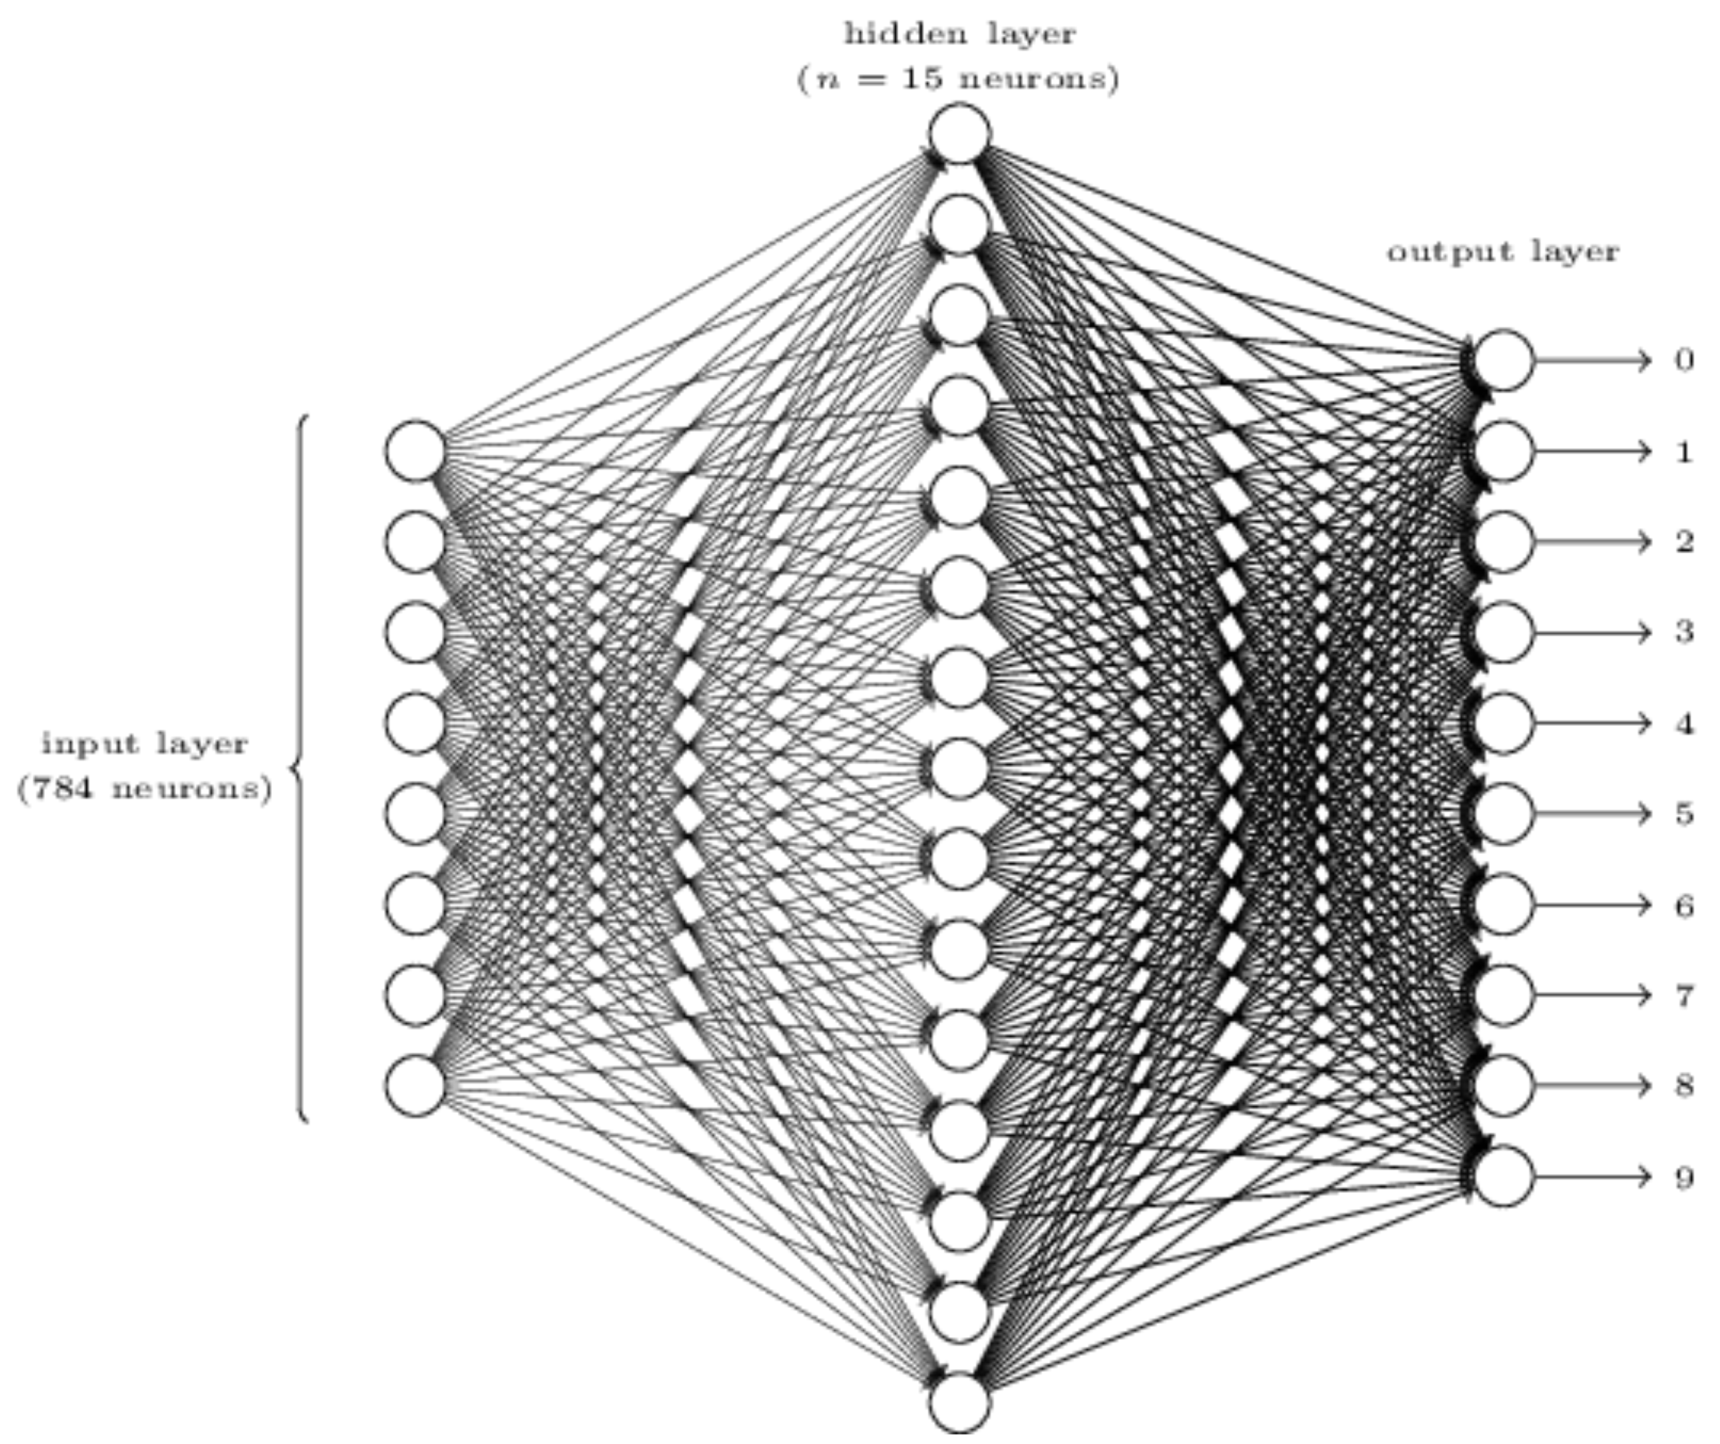
NN for recognizing digits

Slide 83
What needs to be trained
The network (i.e., number of layers, nodes, and edges), and activation functions are static. You define them.
During training, stochastic gradient descent (SGD) adjust the edge weights such that a cost function (J or C), e.g., negative log likelihood, is minimized.

Slide 84
What needs to be trained
Very similar to LR (in fact, LR is a one-layer NN…), but
Computing the derivatives for the hidden layers (which don’t exist in LR) is tricky
We will use the backpropagation algorithm for this purpose
Let’s do this for the feed-forward NN
Required for 539 only

Slide 85
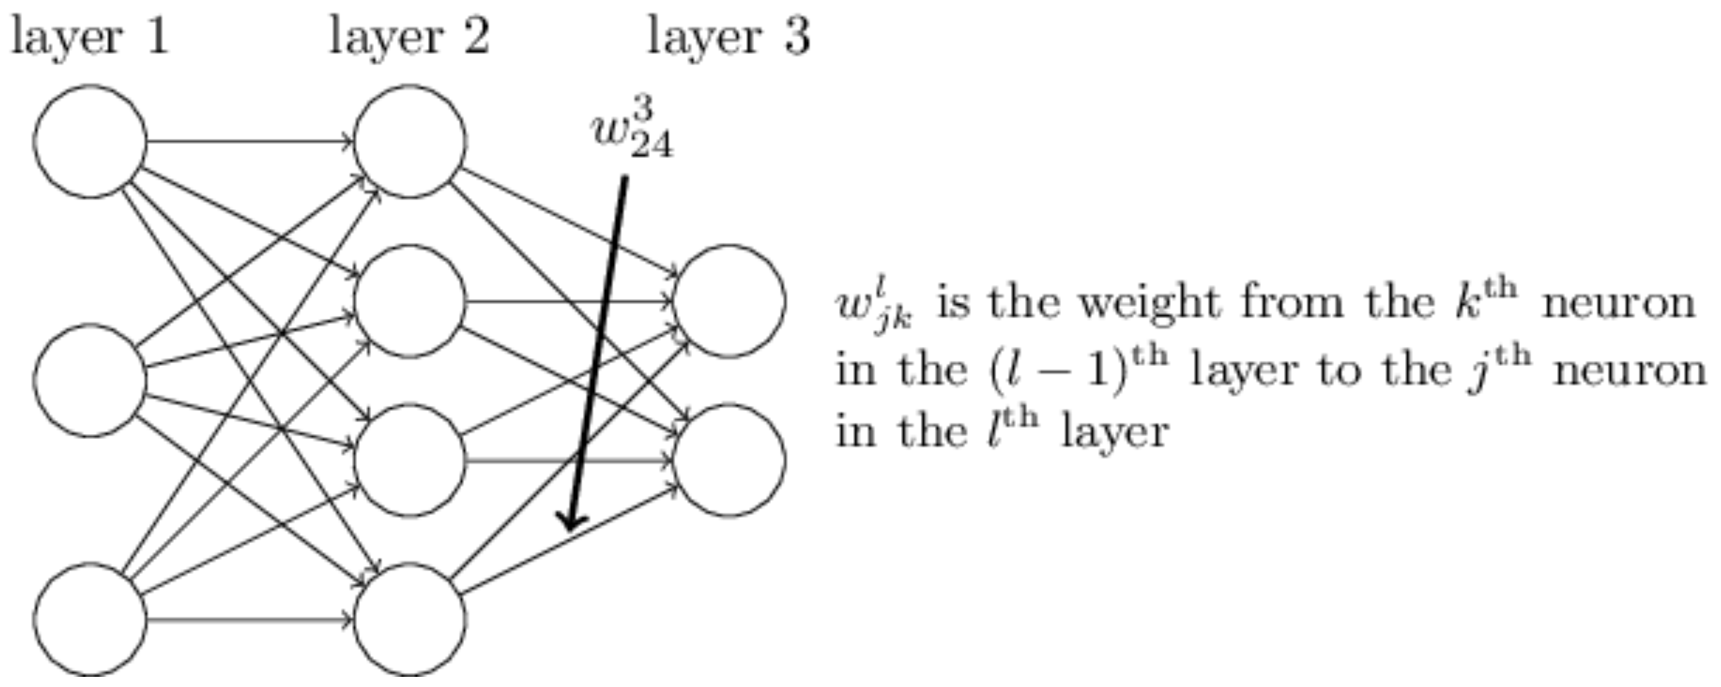
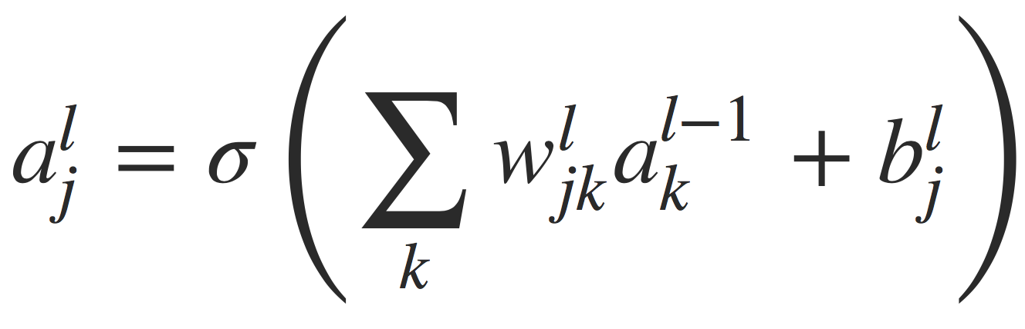
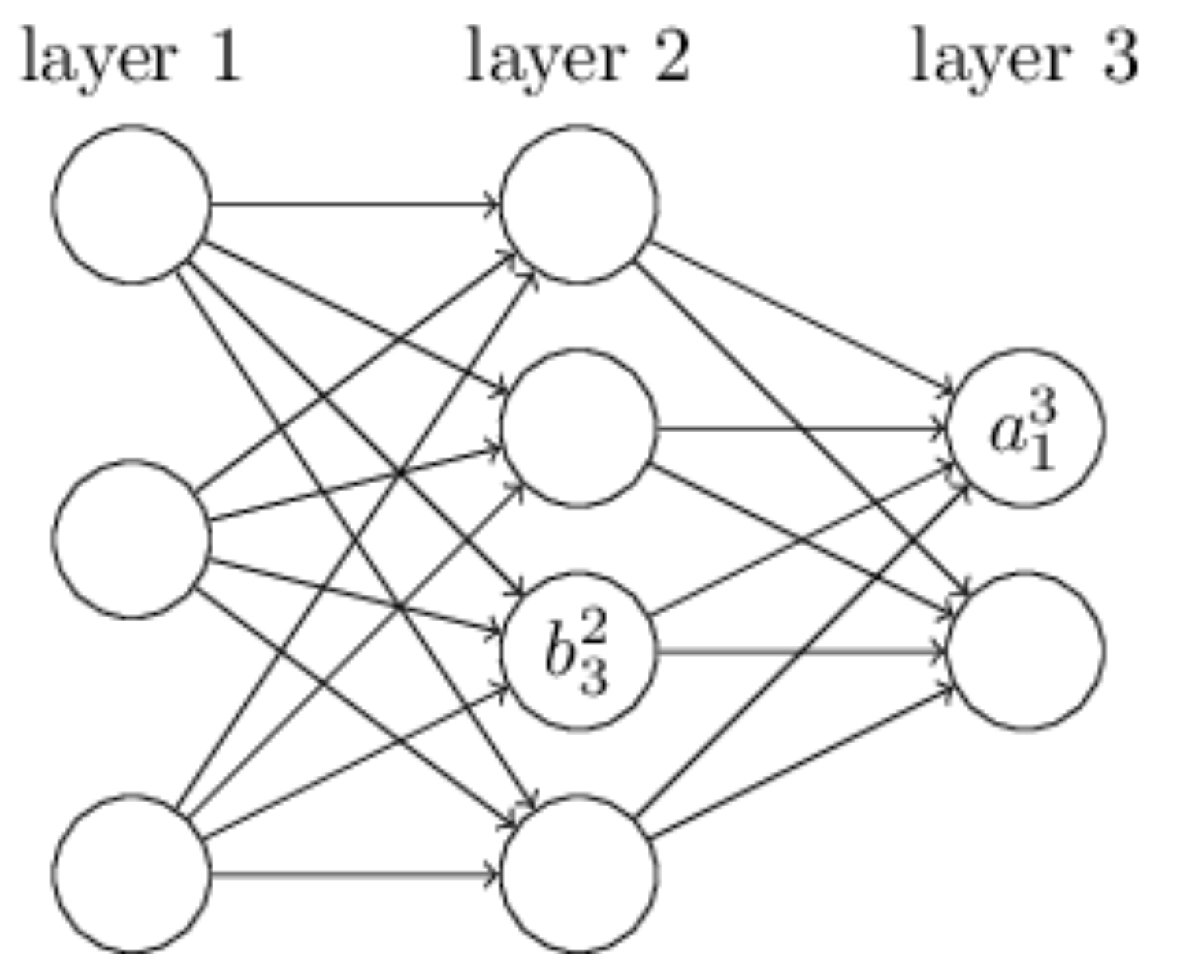
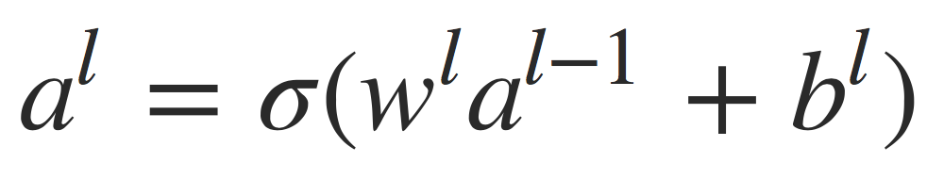
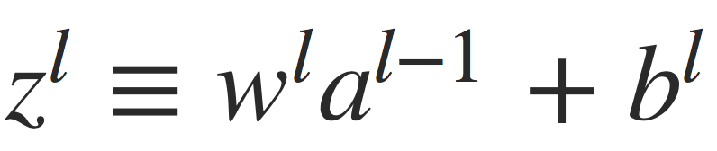
Notations

Slide 86
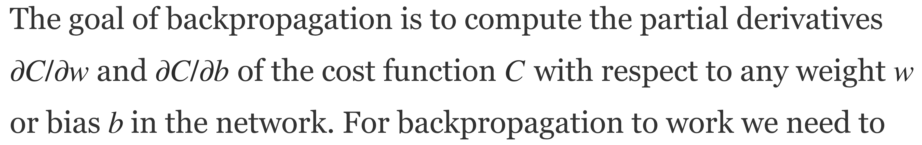
Goal of backpropagation

Slide 87
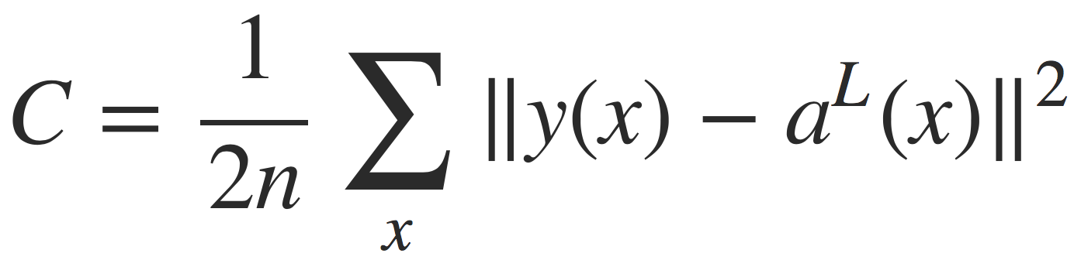
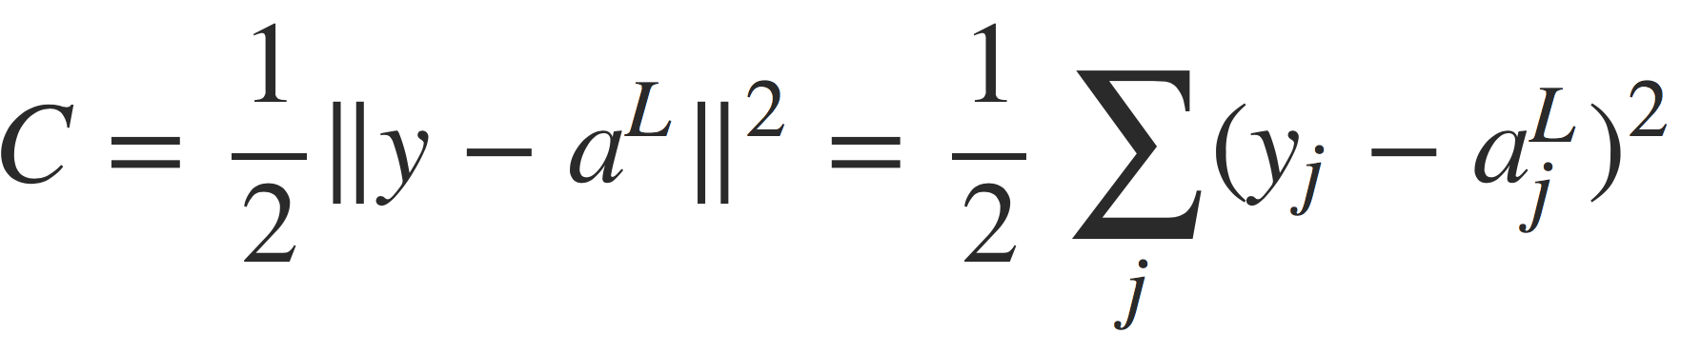
Cost function in this example
Or, for a single training example x:
C = quadratic cost, mean squared error, MSE
But many other cost functions are possible!
(Incomplete) rule of thumb:
If binary classification: MSE
If multiclass classification: cross entropy

Slide 88
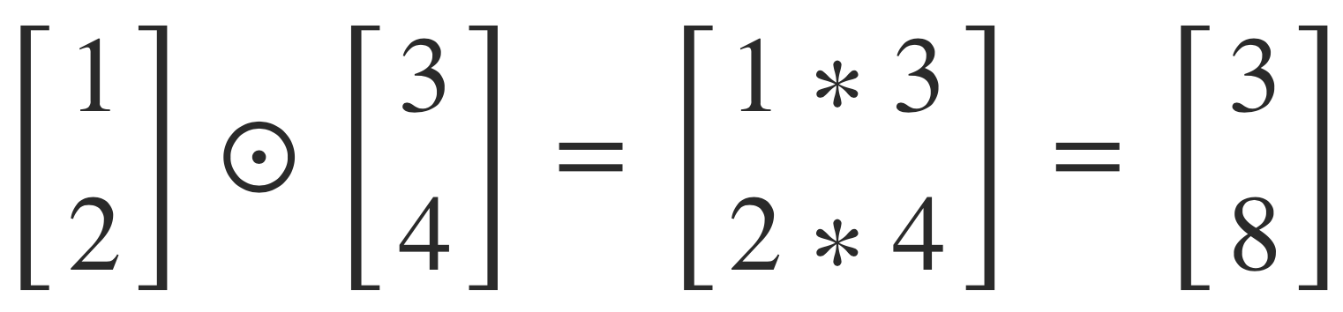

Notes: a few useful formulas
Hadamard product: Element wise multiplication of two vectors:
Error or layer l in the network:

Slide 89

4 equations
Which will compute the partial derivatives of C with respect to w and b, so we can perform gradient descent

Slide 90



BP1
Compute the error in the last layer (L):
Or, in vector form:

Slide 91




Proof of BP1

Slide 92

BP2
Computes the error in layer l as a function of the error in layer l + 1 (hence “backpropagation”):

Slide 93

Proof of BP2 (1/2)

Slide 94



Proof of BP2 (2/2)

Slide 95


BP3 and BP4
Rate of change of cost wrt any bias in the network:
Rate of change of cost wrt any weight in the network:

Slide 96
At-home exercise: proofs of BP3 and BP4
These could be great midterm questions (for grad students)…

Slide 98
Backpropagation + stochastic gradient descent
SGD learns network weights (and bias) for any network, with any decision functions in the nodes, and any cost function
Assuming we can differentiate the decision and cost functions…
SGD is not guaranteed to be optimal!
But it works reasonably well, and it is reasonably fast

Slide 99
Coming up
Next lecture: Automatic feature generation through distributional similarity
Following lecture: DyNet tutorial for feed-forward networks
Rest of the course: structured learning, aka how to learn when the points to be categorized depend on each other?

Slide 100
Readings
For kNN and Rocchio: see chapter 14 in Introduction to Information Retrieval (http://informationretrieval.org)
For Perceptron: see chapter 16 in our textbook
For logistic regression (LR): see Andrew Ng’s notes for LR: Part II in the file cs229_notes1.pdf (in D2L)
For neural networks: see chapters 1 and 2 in Michael Nielsen’s book: http://neuralnetworksanddeeplearning.com

Slide 101
Take-away
Understand the task of text categorization
A few fundamental machine learning (ML) algorithms
K Nearest Neighbors (kNN)
Perceptron
Logistic regression
Feed-forward neural networks

